Slide 1
Refund/Tax Owed
Pub 4012 – Pages K-16 to K-22
Pub 4491 – Lesson 31

Slide 2
Refund/Balance Due
Taxpayer has several choices on how to receive refund or pay amount owed

Slide 3
Refund or Payment?
In TaxSlayer, amounts are shown at top of screen,
  Green is a refund
  Red is owed
Also on 1040 view, Lines 63 - 78
Notes:
myRA contributions will be permitted on the 2015 return – either on Form 1040 or Form 8888(?)

Slide 4
Refund Options
Receive refund by check
Receive refund by Direct Deposit
  One account -OR-
  Split refund
    Up to three different accounts
    Can deposit to MyRa account
    Can purchase US Series I Savings Bond
    Can receive a portion in a check
Apply some or all to next year’s tax
Notes:
Next year’s tax is line 75
myRA contributions will be permitted on the 2015 return – either on Form 1040 or Form 8888(?)

Slide 5
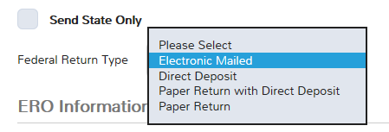
Receive a Check
In e-file section, mark return as Electronic Mailed

Slide 6
Direct Deposits
Encourage Direct Deposit – Pub 4012,
Pg K-16
  Faster (1-2 weeks versus 3+ weeks by mail)
  Safer
Best to take numbers from current check with nine-digit routing transit number and account number
Notes:
Bank deposit slips are not a reliable source for routing and account numbers for direct deposit
Enter the account number from left to right, but omit spaces and symbols and do not include check number
Do not assume that you know routing number because you use same bank – most banks have several RTNs
Can also send refund to fund IRA if Taxpayer has RTN and account number

Slide 7
Verify Banking Information
If taxpayer does not have check or letter from bank, may accept information from another source if
  Counselor advises taxpayer of responsibility for accuracy – money will most likely be gone for good if incorrect
  Taxpayer initials printed return next to routing and account numbers
Notes:
Optional Method use must be authorized by LC from DC – It is not an individual counselor option.
See http://www.irs.gov/uac/Refund-Returns

Slide 8
Direct Deposits
IRS will send refund to savings account, but its routing transit number is often not easy to locate
IRS recommends direct deposit of refund go only to account (or accounts) in taxpayer’s name
Financial institutions may not allow joint refund to be deposited into an individual account
Notes:
Bank deposit slips are not a reliable source for routing and account numbers for direct deposit.
Enter the account number from left to right, but omit spaces and symbols and do not include check number.
Do not assume that you know routing number because you use same bank – most banks have several RTNs

Slide 9
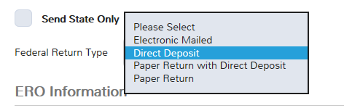
Direct Deposit of Refund
In e-file section, select Direct Deposit
Notes:
What are the benefits of direct deposit?
Encourage taxpayers to use direct deposit; direct deposit refunds are received faster than checks (usually within 10 to 14 days) and eliminate the possibility of a check being lost or stolen. Direct deposit is more convenient for the taxpayer.
Direct deposit saves tax dollars because it costs the government less.

Slide 10
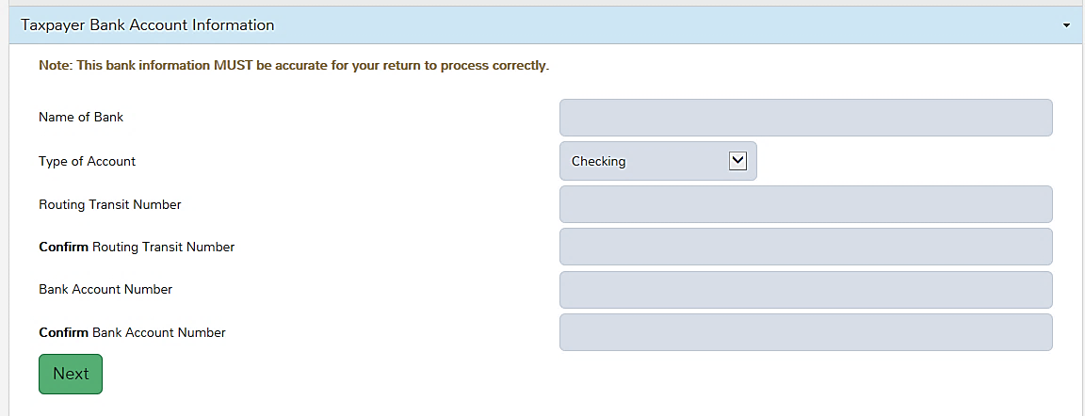
Direct Deposit of Refund
Enter routing and account numbers twice

Slide 11
Direct Deposit Refund to Multiple Accounts – Form 8888
Up to three accounts
Including MyRa account
Part of the refund can be by check
Not available in Practice Lab
Notes:
SCREENS NOT AVAILABLE IN PRACTICE LAB

Slide 12
Series I Bonds – Form 8888
Can buy for self or others in $50 increments
Can buy up to three in a range of amounts
Fixed rate interest + semiannual inflation
Notes:
Current interest rate is very low: inflation + 0.1%
12

Slide 13
Savings Bonds – Form 8888
Can redeem after 12 months (forfeit 3 months interest if redeemed <5 years
Taxpayer will receive bonds via mail and check for balance of refund
Not available in Practice Lab
Notes:
Bonds will not be issued if any of the following apply:
• The bond request is not a multiple of $50
• More than one name is entered on line 5b, 5c, 6b, or 6c
• The refund is decreased because of a math error
• The refund is offset for any reason
Instead, the entire refund will be sent to the taxpayer in the form of a check

Slide 14
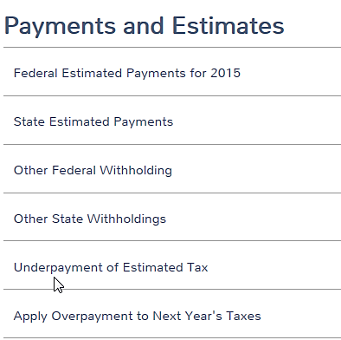
Apply Refund to Next Year
In Payments & Estimates section, select Underpayment of Estimated Tax
Notes:
Can also enter on next year’s estimated payment form worksheet – 1040-ES, covered in another lesson

Slide 15
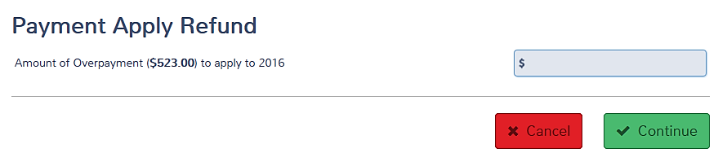
Apply Refund to Next Year
May be reduced if IRS makes adjustment to return
Notes:
Can also enter on next year’s estimated payment form worksheet – 1040-ES, covered in another lesson

Slide 16

Payment Due Options—
(By April 18th)
Pub 4012, page K-18
Check or money order mailed with Form 1040-V, Payment Voucher
  TaxSlayer will prepare voucher
Electronic funds transfer (ACH)
IRS Direct Pay
Credit card (may have additional fee)
Electronic Federal Tax Payment System (EFTPS)
Notes:
16
Electronic funds transfer is also referred as “direct debit”
IRS Direct Pay from www.irs.gov
Credit card fees may be imposed for ‘cash advance’
EFTPS if already enrolled for some other purpose

Slide 17
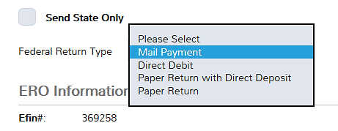
Payment Due—Check
From e-file section, select Mail Payment

Slide 18
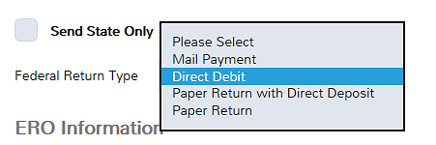
Payment Due—ACH Option
From E-file section, select Direct Debit

Slide 19
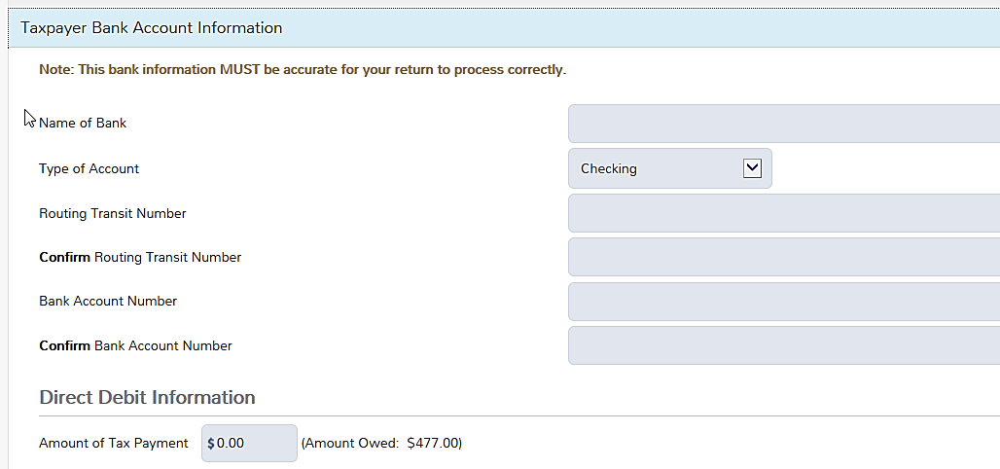
Payment Due – ACH Option
Enter bank numbers twice, amount and date

Slide 20
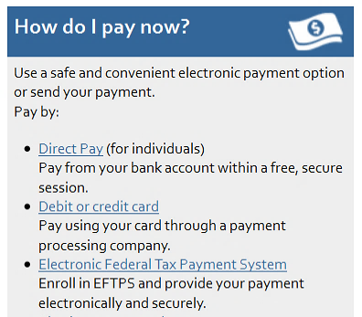
Payment Due—Direct Pay,
Credit Card or EFTPS
Pub 4012, page K-18
Taxpayer does on own through irs.gov/Payments
Notes:
20
Electronic funds transfer is also referred as “direct debit”
Credit card fees may be imposed for ‘cash advance’

Slide 21
Can’t Pay Now
Full Pay in 60 or 120 Days
Monthly Installment Payments

Slide 22
Full Pay in 60 or 120 Days
No user fee
Interest and penalties apply on amounts paid after April 15
Apply online at irs.gov/Payments → Online Payment Agreement Application
File return on time or penalty is much higher!
Notes:
This only stalls the nasty letters from IRS
Interest is 4% per year
Penalty for late payment is ½ of 1% per month (or part of month)
Penalty for late filed return is 5% per month
Taxpayer would do on their own

Slide 23
Installment Payments
Through www.irs.gov/payments OR
In Miscellaneous Forms section, select Installment Agreement (Form 9465)—NEW HIGHER FEES
Notes:
State may have similar installment payment option

Slide 24
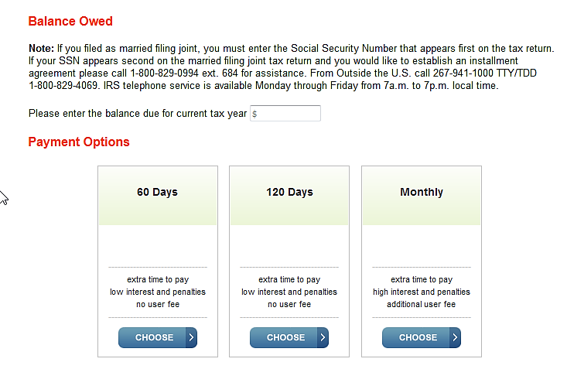
Online Payment Agreement at www.IRS.gov/payments
Notes:
Interest is 4% per year
Penalty for late payment is ½ of 1% per month (or part of month)
Penalty for late filed return is 5% per month
Taxpayer would do this on their own

Slide 25
Monthly Installment Payments—
Proposed 1/1/2017 Fee Schedule
Filing Form 9465—$225 (if direct debit—$107)
Online payment agreement—$149 (if direct debit—$31)
Interest and penalties added
Notes:
If 13844 not in TaxWise for 2013, Taxpayer would need to complete and send in separately

Slide 26
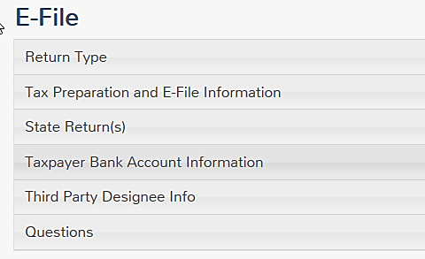
Third Party Designee
In E-file
section
May NOT be
Tax-Aide
volunteer
Adult child of elderly parents
Family member of overseas taxpayer

Slide 27
Line 77 Estimated Tax Penalty
If tax owed is $1,000 or more AND
Withholding and estimated payments less than the smaller of:
  90% of tax shown on current tax return OR
  100% of tax shown on 2015 tax return
Advise the taxpayer of possible penalty
Notes:
For high income taxpayers (>150,000 or >75,000 MFS), must have paid 110% of prior year’s tax
“Tax shown on return” is defined in the instructions to Form 2210

Slide 28
Line 77 Estimated Tax Penalty
We do not calculate penalty
IRS will automatically compute whether penalty is due based on current year or prior year’s facts
IRS will send notice and bill if appropriate
Notes:
Clarify
What to do for your state to zero out any penalty

Slide 29
Quality Review
No estimated tax penalty shown
Verify bank information if direct deposit or direct debit
Verify ACH forms are correct
State refund or balance due options?

Slide 30
Summary with Taxpayer
Refund or balance due
If paying balance due by check, ensure s/he understands when/how to mail it
If under or over withheld
  Revise withholding – Forms W-4
  Estimated taxes (another lesson)
If possible penalty, be sure taxpayer is aware may receive notice/bill from IRS

Slide 31
Summary with Taxpayer
If the taxpayer owes taxes and is unable to pay full amount, the counselor should explain the various payment options and fees and how to get to www.irs.gov/payments

Slide 32

Refund/Tax Due
Questions?
Comments…

